Slide 1
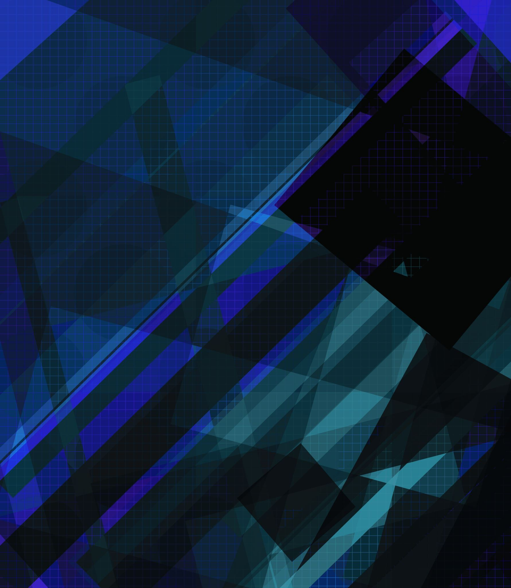
CW2 PROJECT the PacNan Game Presented by: Rayan Hamour Araoluwa Olatunji Adel Abdeldaim

Slide 2
Introduction: This is a game in which the user will be able to play a classic game of Pacman which is inspired by the real Pacman

Slide 3
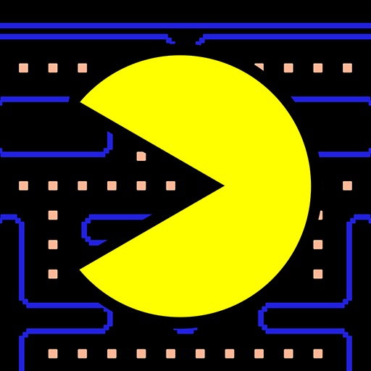

Game Requirements: The main characters are Pacman and the ghosts. 1-The user can move the Pacman around in four directions. 2-There are many orbs waiting to be eaten. 3-If Pacman collides with an orb the orb is eaten, and the player’s score increases. 4-If Pacman eats a cherry, it is able to eat ghosts greatly increasing the score

Slide 4
Design considerations We had to consider the classes that would be necessary such as the ghosts, and Pacman himself. The layout of the map needed to be considered as we would need to place all the ghosts in even places to prevent the player from an instant game-over
Notes:
When designing the game, we needed to make sure that it would be as close to the original game as we could make it within the time limit and the scope of our programming ability
so features, like the ghosts turning into eyes and returning to base to regenerate like in the original game, were ultimately discarded in the planning stages
We also chose to simplify the character designs by making the ghosts into circles of different colors, using a .Png to be the image used to define the walls of the game map, and using a draw method to make a circle with effects that allow it to have a “mouth” that opens and closes with some code.

Slide 5
Overview of classes The classes present in the game are:
Pacman, as the player’s entity
The ghosts, as the opposition
The small orbs, which function as the way to get point
The Cherries (larger orbs) that function as the way to enable the ghost fear state that makes them consumable
The walls as tangible objects that cannot be passed through

Slide 6
Development of the game: these are the difficulties we had when we were working on the game : Player collision with ghosts Player collision with ai Audio Ghost AI Circle-circle collision Circle-square collision Pathfinding More features visual Scoreboards Sound effects Personal difficulties with pc’s
Notes:
The only issues with the player collision with the ghost was making sure that on direct collision the sound effects would play and that the spite for the ghosts, pellets and power up were properly spliced without any errors, an issue we face in development was a case were the sound effects of the game would not play upon launch which was resolved after troubleshooting
Some issues faced with pathfinding was the randomisation of the paths the ghosts would take and how to make sure it was truly random every time this was also resolved by using a constant called pathways which would use an array that stored previous collisions recognising them as paths that couldn’t be taken and only using the paths that can be taken to provide information as to where travel is possible

Slide 7
Evaluation: This project helped us gain a lot of knowledge of coding in javascript and made us look for better improvement in the IT industry, allowing us to see the future of the courses we have applied for and helping us acknowledge the teamwork environment and problem-solving skills that we have.

